Slide 1
Constructive Computer Architecture
Networks-on-Chip
Part I: Flow Control & Router Microarch
Jianming Tong + Tushar Krishna
Electrical Engineering and Computer Science
Massachusetts Institute of Technology

Slide 2
Recap: Symmetric Multiprocessors
Processor
+ cache
Processor
+ cache
Processor-Memory Interconnect
bridge
Memory
I/O Interconnect
I/O controller
I/O controller
I/O controller
All memory is equally accessible to all processors
Any processor can do any I/O operation
Graphics
output
Networks
Notes:
Shared Memory Abstraction
Case 1: same cores
Case 2: multiple cores.

Slide 3
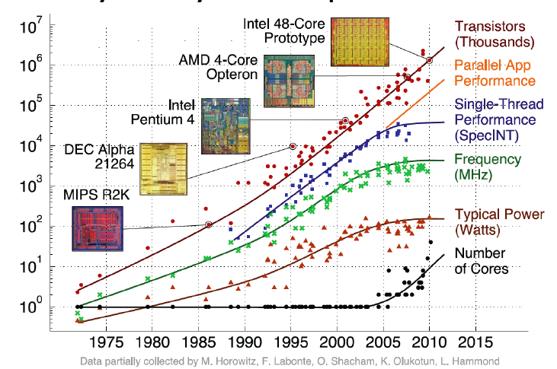
Technology Trends: Multiple cores on single chip

Slide 4
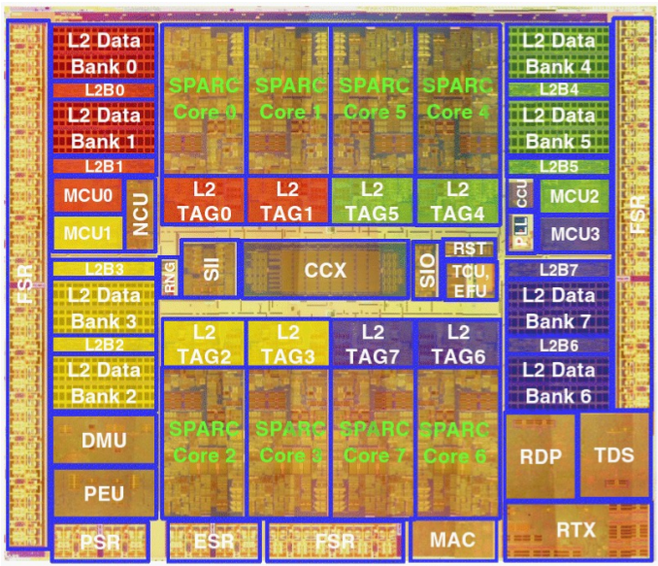
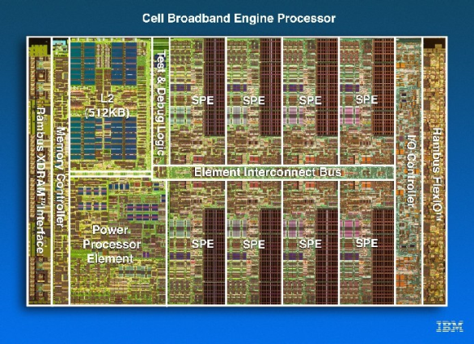
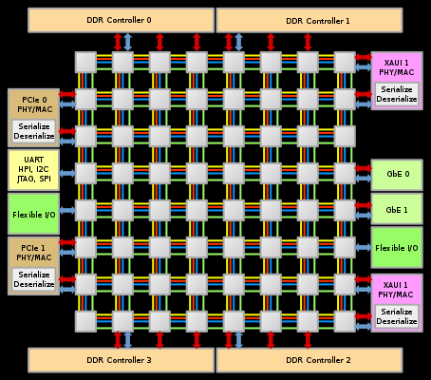
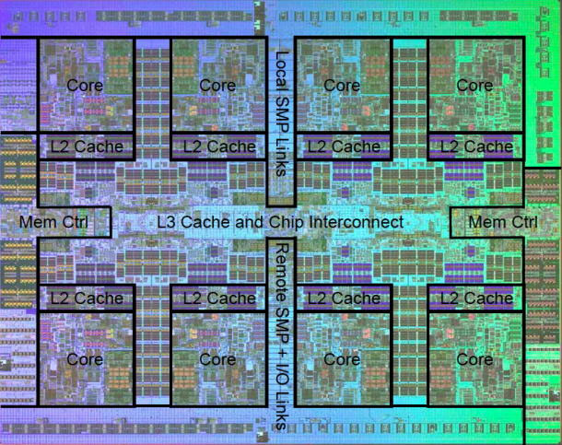
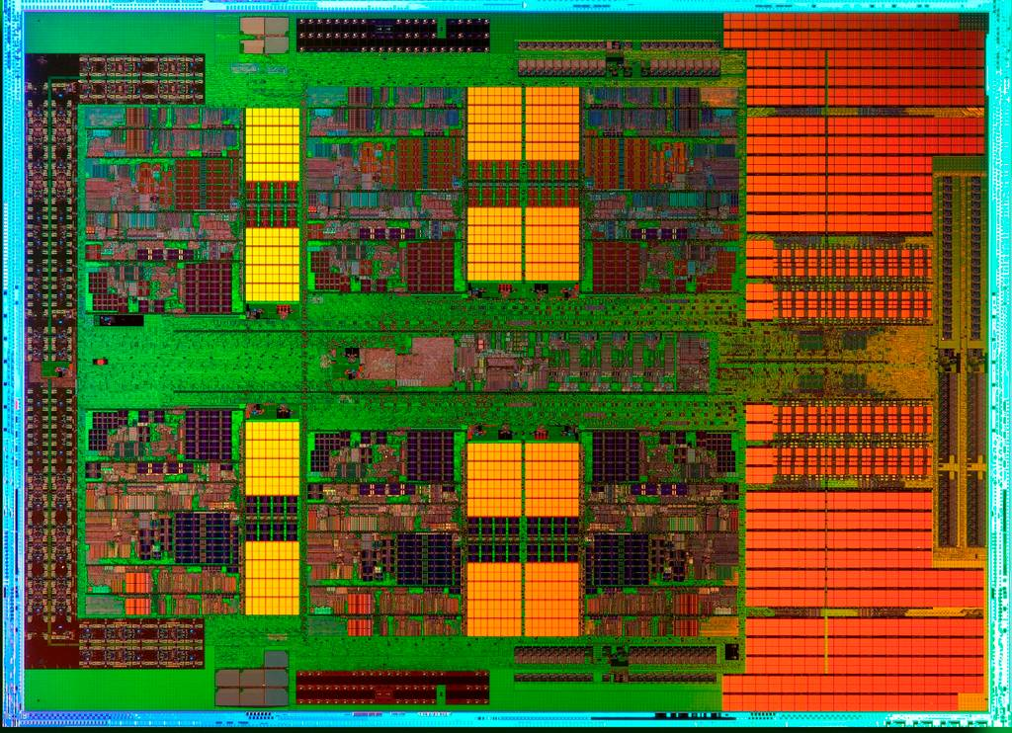
Commercial Multicore Chips
Sun UltraSpac T2
8 Cores
Intel Teraflops 80 Cores
IBM Cell
8 Cores
Tilera Tile64 64 Cores
IBM Power 7 8 Cores
AMD MagnyCours 12 Cores

Slide 5
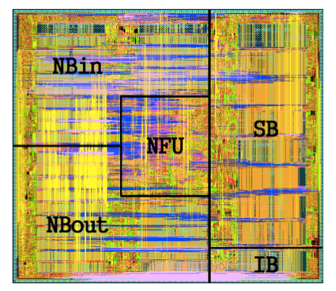
Accelerator Chips
ShiDianNao
64 PEs
NVIDIA Pascal
64 CUDA cores (per SM)
60 SMs
Google TPU
256x256 MACs
IBM TrueNorth
4096 cores
MIT Eyeriss
168 PEs
Deep Learning Accelerators

Slide 6
Recap: Symmetric Multiprocessors
Processor
+ cache
Processor
+ cache
Processor-Memory Interconnect
bridge
Memory
I/O Interconnect
I/O controller
I/O controller
I/O controller
All memory is equally accessible to all processors
Any processor can do any I/O operation
Graphics
output
Networks
Notes:
Shared Memory Abstraction
Case 1: same cores
Case 2: multiple cores.

Slide 7
Network-on-Chip (NoC)
Core + L1$
Core + L1$
Core + L1$
Core + L1$
Core + L1$
Core + L1$
Network-on-Chip
L2$
L2$
L2$
L2$
L2$
L2$

Slide 8
What traffic goes on the NoC?
Cache Coherence!
child
A downgrade request always completes and therefore it can share the same FIFO as for response messages
Upgrade Req
c2m
m2c
Dngrade Resp
Upgrade Resp
interconnect
Dngrade Req
c2m
m2c
parent
Two FIFOs guarantee that an upgrade request cannot block a response message

Slide 9
Modern NoCs
Core
L1
D$
L1
I$
L2$
Network Interface
L3$/Directory
Router
“Tile”
Core will not be shown explicitly in the rest of the slides. Only the routers will be.
Mesh
“Tile”
Ring

Slide 10
NoC Metrics
Performance
Latency
Delay to deliver a message
Throughput
How many messages are delivered per cycle
Power
Links
Routers
Area
Links
Routers

Slide 11
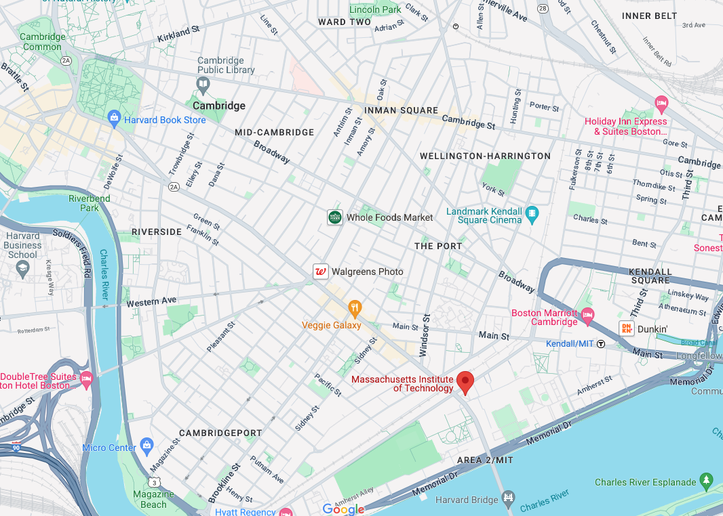
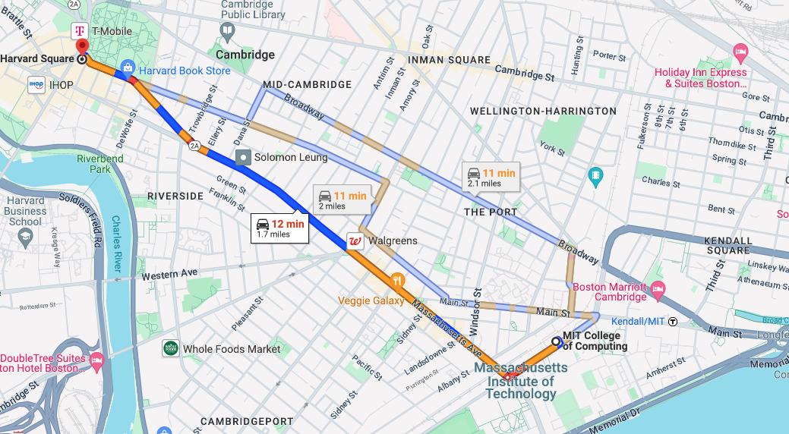
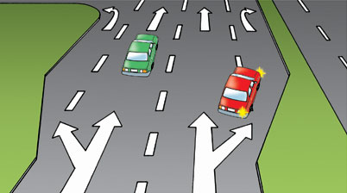



Network Architecture
Topology
How to connect the nodes
~Road Network
Routing
Which path should a message take
~Series of road segments from source to destination
Flow Control
When does the message have to stop/proceed
~Traffic signals at end of each road segment
Router Microarchitecture
How to build the routers
~Design of traffic intersection (number of lanes, algorithm for turning red/green)

Slide 12


How are messages sent?
Message
Header
Payload
Packet
Route
Seq#
Head Flit
Body Flit
Tail Flit
Flit
Type
VCID
Head, Body, Tail, Head & Tail
x40
x10
Harvard Square
6.192 classroom
Packet
Message
Flit

Slide 13
Packet Switching
Messages composed of one or more packets
If message size is <= maximum packet size only one packet created
Packets composed of one or more flits
Flit size same as link width
Link segments allocated at packet/flit granularity
x40
x10
Harvard Square
CS 6.192 classroom
Packet
Message
Flit

Slide 14
Typical NoC Packets
Cache line
Route
Type
VCid
Addr
Bytes 0-15
Bytes 16-31
Bytes 32-47
Bytes 48-63
Head Flit
Body Flits
Tail Flit
64B Cache Line
128-bit flits (i.e., link width)
1 control flit (cache line req)
5 data flits (cache line data)
Cache Line Request
Route
Type
VCid
Addr
Cmd
Head_Tail Flit
Packet contains destination/route information
Flits may not → all flits of a packet must take same route

Slide 15
Network Architecture
Topology
How to connect the nodes
~Road Network
Routing
Which path should a message take
~Series of road segments from source to destination
Flow Control
When does the message have to stop/proceed
~Traffic signals at end of each road segment
Router Microarchitecture
How to build the routers
~Design of traffic intersection (number of lanes, algorithm for turning red/green)
Today’s class

Slide 16
Designing a NoC
Suppose the cores are connected in a ring
Core
Core
Core
Core
Core
…
Core
Core
Core

Slide 17
Designing the Ring Stop
…
Input from Core
1. Who should use output link?
?
Ring
2. What to do with the other flit (from ring/core)
Have you seen this same situation in real life on a road network?
Output to Core

Slide 18
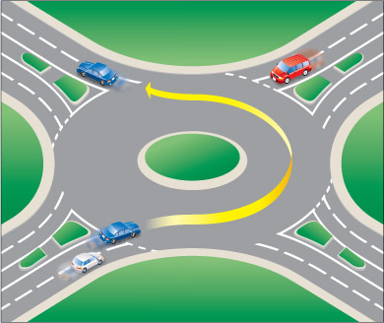
Real life example
1. Who should use output link?
Traffic already on ring has priority
2. What to do with the other flit (from ring/core)
Wait

Slide 19
Network Architecture
Topology
How to connect the nodes
~Road Network
Routing
Which path should a message take
~Series of road segments from source to destination
Flow Control
When does the message have to stop/proceed
~Traffic signals at end of each road segment
Router Microarchitecture
How to build the routers
~Design of traffic intersection (number of lanes, algorithm for turning red/green)

Slide 20
Need for Flow Control
Contention!
Two packets trying to use the same link at the same time
Why?
Multiple packets sharing same links
Why not all to all connectivity?
Not scalable (next lecture)

Slide 21
Handling Contention
…
Input from Core
1. Who should use output link?
?
Traffic already on ring has priority
Note: opposite policy also possible.
Ring
2. What to do with the other flit (from ring/core)
Wait
Output to Core

Slide 22
Implementing Flow Control
The control structure is called an “arbiter”
1. Who should use output link?
Traffic already on ring has priority
Input from Core
Input from Core
This is known as “arbitration”
New Flit
Output to Core
Output to Core
2. What to do with the other flit (from ring/core)
Full
3. What should a flit do if its output is blocked?
Wait

Slide 23
Flow Control: Buffer Management
What should a flit do if its output is blocked?
Option 1: Drop!
Send a NACK back for dropped packet or have a timeout
Source retransmits
Implicit congestion control
Flow control protocol on the Internet
Advantage: can be bufferless!
Challenges?
Latency and energy overhead of re-transmitting more than that of buffering so not preferred on-chip

Slide 24
Flow Control: Buffer Management
What should a flit do if its output is blocked?
Option 2: Misroute!
As long as N input ports and N output ports, can send flit out of some other output port
called “bouncing” on a ring
Advantage: can be bufferless!
Challenges?
Energy
Routes become non-minimal – more energy consumption at router latches and on links
Performance
Non-minimal routes – can lead to longer delays
Correctness
Livelock! – cannot guarantee forward progress
Need to restrict number of misroutes of same packet

Slide 25
Flow Control: Buffer Management
What should a flit do if its output is blocked?
Option 3: Wait!
Signal to previous router to not send any more flits till the input at this router can be drained
Backpressure techniques
On/Off : one bit to signal if next router can receive or not
Challenge: Delay of on/off signal
Credit-based : A count of how many flits can be sent to the next node?
When should credit be decremented?
When should credit be incremented?
Whenever a flit is sent to the next router
Whenever a flit leaves the next router
Note: In NoC lab you will use On/Off

Slide 26
Flow Control: Link and Buffer Allocation
Buffers
Per Packet
Per Flit
Store and Forward Virtual Cut Through | Wormhole
X | Virtual Channel
wait for entire packet to arrive before forwarding
Buffer can be smaller than entire packet
Per Packet
May block channel mid-packet
start forwarding as soon as flit arrives
Links
Interleave flits of different packets on link
Per Flit
Complex Router

Slide 27
Wormhole Flow Control
Channel idle but red packet blocked behind blue
6 flit buffers/input port
Dest for Red
Buffer full: blue cannot proceed
Red holds this channel: channel remains idle until red proceeds
Blocked by other packets
“Head-of-Line Blocking”
Dest for Blue
Notes:
Imagine being stuck behind a car that wants to turn but you want to go straight

Slide 28
Virtual Channels
When a message blocks, instead of holding on to physical links so others can’t use them, hold on to virtual links (i.e., buffers)
Analogous to lanes on the highway
“Right-only” lane so that traffic going straight does not block
Disadvantages?
More complex router (multiple sets of queues)
Arbitration between VCs required

Slide 29
Virtual Channel Flow Control
6 flit buffers/input port
3 flit buffers/VC
Dest for Red
Buffer full: blue cannot proceed
Blocked by other packets
Dest for Blue

Slide 30
Flow Control Protocols
Bufferless
Circuit switching
Dropping
Misrouting
Buffered
Store-and-forward
Virtual cut-through
Wormhole
Virtual-channel
Complexity
&
Efficiency

Slide 31
Network Architecture
Topology
How to connect the nodes
~Road Network
Routing
Which path should a message take
~Series of road segments from source to destination
Flow Control
When does the message have to stop/proceed
~Traffic signals at end of each road segment
Router Microarchitecture
How to build the routers
~Design of traffic intersection (number of lanes, algorithm for turning red/green)

Slide 32
What does a router look like?
Route
Compute
BW: Buffer Write
VC Allocator
RC: Route Compute
SW Allocator
Input Buffers
VA: VC Allocation
Input VCs arbitrate for “output” VCs (Input VCs at next router)
VN0
VC 0
FLIT
VC 1
Crossbar Switch
VN
1
VC n
…
SA: Switch Allocation
Input ports arbitrate for output ports
Input Buffers
VC 1
VC 2
BR: Buffer Read
Input Ports
VC n
Output Ports
ST: Switch Traversal
LT: Link Traversal
BW
RC
VA
SA
BR
ST
LT

Slide 33
Router Microarchitecture
Route
Compute
VC Allocator
Components
Virtual Channel Buffers
Routing Logic
Allocation
Switch Allocation
VC Allocation
Crossbar Switch
Link
Pipeline
SW Allocator
Input Buffers
VN0
VC 0
VC 1
Crossbar Switch
VN
1
VC n
Input Buffers
VC 1
VC 2
VC n

Slide 34
Virtual Channel Buffers
Why are VCs used?
Correctness: Avoid Cache Coherence Deadlock
Performance: Avoid “Head-of-line Blocking”
How are VCs implemented?
“Separate” queues at each input port
Implementation Choices:
Physically separate set of queues
Logically separate and share a common pool of buffers
Each packet arrives with a VCid
Selects a VC at the previous router
Previous router needs to know how many VCs empty
This information is conveyed via “credits” or On/Off
Question: Many shallow VCs or few deep VCs?

Slide 35
VC and Switch Allocation
“Allocator” matches N requests to M resources
“Arbiter” matches N requests to 1 resource
VC Allocation
Requests: Input VCs
Resources: Output VCs (i.e., VCs at next router)
Switch Allocation
Requests: Input VCs/Input ports
Resources: Output ports of the router
Allocator that delivers the highest matching translates to higher network throughput
Must also be fast and/or able to be pipelined
More discussion in recitation!

Slide 36
Switch (Crossbar)
Input-driver
Mux
Pass-gate switch
Mux-based Crossbar
Matrix Crossbar
+ Synthesizable from RTL
- Typically More Area and Power
+ Lower area and power
- Requires careful custom design

Slide 37
Crossbar Scalability
Key Challenges
Area and power scale at O((pw)²)
p: number of ports (function of topology)
w: port width in bits (determines phit/flit size and impacts packet energy and delay)
Arbitration in a large crossbar is challenging
Crossbar Optimizations
Dimension-Slicing
2x2 crossbar for X-dimension
Local, X
3x3 crossbar for Y-dimension
Local, Y, X (i.e., turning)
Bit-Interleaving / Double-pumping (e.g., Intel SCC)
Send alternate bits on positive and negative phase of clock

Slide 38
Router Pipeline vs Processor Pipelining
Processor
Router
Logical Stages
IF
ID
EX
MA
WB
Instructions go through all/some stages
Multiple kinds of instructions
There can be multiple implementations for each stage
Logical Stages
BW
RC
VA
SA
BR
ST
LT
Flits go through all/some stages
Multiple kinds of flits
There can be multiple implementations for each stage
Today: most NoC routers have 1-2 pipeline stages

Slide 39
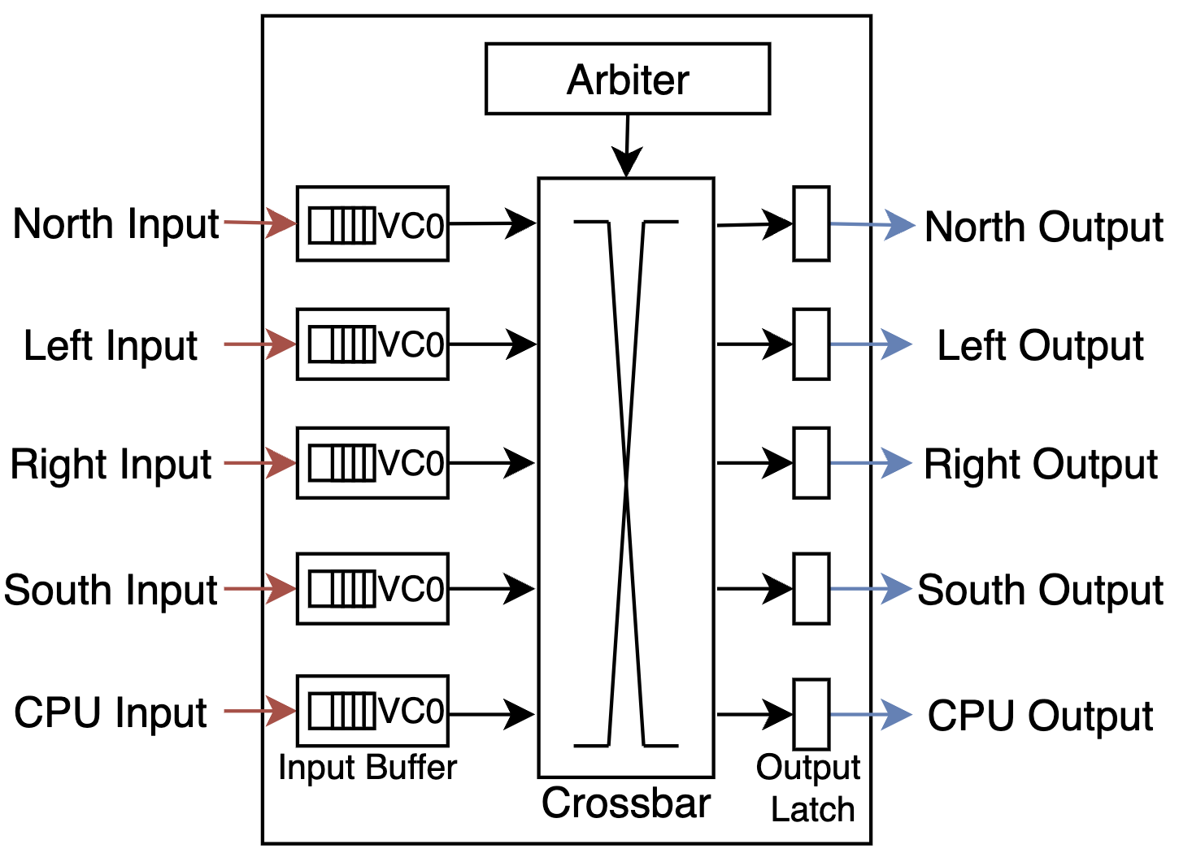
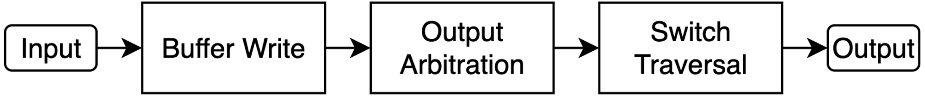
Router for Lab
Three logical Stages. One Cycle

Slide 40
Network Architecture
Next class
Topology
How to connect the nodes
~Road Network
Routing
Which path should a message take
~Series of road segments from source to destination
Flow Control
When does the message have to stop/proceed
~Traffic signals at end of each road segment
Router Microarchitecture
How to build the routers
~Design of traffic intersection (number of lanes, algorithm for turning red/green)

Slide 41
Backup

Slide 42
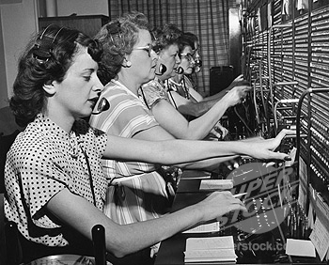
Circuit Switching
Form a circuit from source to dest
Probe to set up path through network
Reserve all links
Send data through links
Bufferless
Tear down circuit once transmission complete
DC
DA
DB
SA
SB
SC

Slide 43
Circuit Switching Example
0
Configuration Probe
5
Data
Circuit
Acknowledgement
Significant latency overhead prior to data transfer
Data transfer does not pay per-hop overhead for routing and allocation

Slide 44
When does circuit switching make sense?
When sending large chunks of data
How large is the data being sent across the chip in shared memory NoCs?
Cache Line – 64B
Suppose
Link Width – 128b
64x8/128 = 4 chunks of data
1-cycle per hop
Setup Time: 3 cycles
ACK Time: 3 cycles
Data Transfer Time: 3 (for first chunk) + 3 (remaining chunks) cycles = 6 cycles
Total Time = 12 cycles
Half of the time went in circuit setup!

Slide 45
How is contention handled?
Wait till Data transmission from 0 complete!
0
1
2
Configuration Probe
5
Data
Circuit
Acknowledgement
When there is contention
Significant wait time
Message from 1 → 2 must wait

Slide 46
Arbiter Example
1
1
REQS
GRANT
0
0
4:1 Arbiter
1
0
1
0

Slide 47
Allocator Example
Suppose 4 requestors (A, B, C, D) and 3 resources (X, Y, Z)
12:3 Allocator
1
1
1
Request A:
X, Y, Z
1
0
0
0
Grant X:
A
1
0
1
Request B:
X, Z
0
0
0
0
Grant Y:
0
0
0
1
Request C:
Z
0
0
0
1
Grant Z:
D
1
0
1
Request D:
X, Z

Slide 48
Possible Implementation: Separable Allocator
Suppose 4 requestors (A, B, C, D) and 3 resources (X, Y, Z)
12:3 Allocator
Easier to implement in HW but not very efficient
1
1
1
3:1 arbiter
Request A:
X, Y, Z
1
0
0
0
4:1 arbiter
Grant X:
A
1
0
1
3:1 arbiter
Request B:
X, Z
4:1 arbiter
0
0
0
0
Grant Y:
0
0
0
1
3:1 arbiter
Request C:
Z
4:1 arbiter
0
0
0
1
Grant Z:
D
1
0
1
3:1 arbiter
Request D:
X, Z

Slide 49
Separable Switch Allocator
Intel SCC (48-core, 45nm) in 2012
N input ports, v VCs per input port
N x v : N Allocator
Stage 1: At every input port, choose one VC
N v:1 allocators
Stage 2: At every output port, choose one input port

